Slide 1
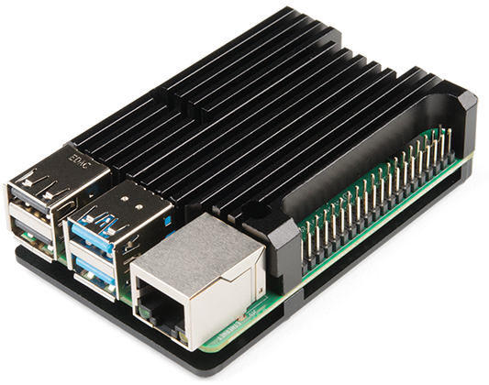
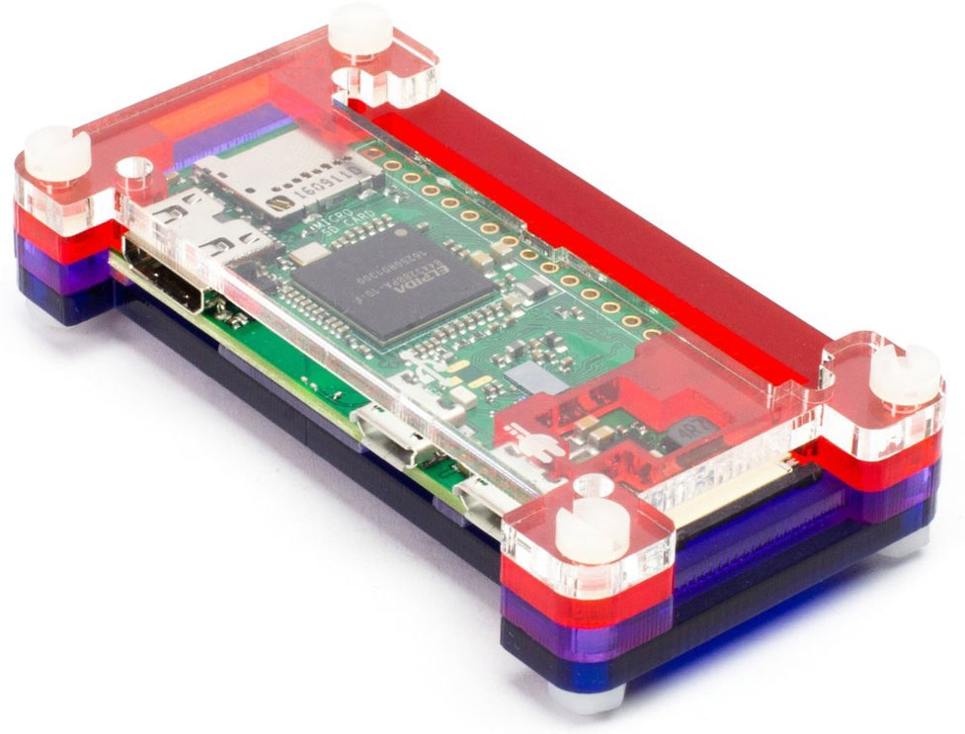
Azure IoT Central Air Quality Monitor Solution
Built and debugged on Raspberry Pi 4
Dockerised and run on Raspberry Zero

